Slide 1
Laptop Price Prediction System Using Random Forest Algorithm
By Ayush Silwal

Slide 2
Introduction
The Laptop Price Prediction System is an web based system developed to predict laptop prices based on their specifications using Random Forest Algorithm

Slide 3
Objectives of this project
To Predict price of laptop based on specification
To view prediction history

Slide 4
Problem statement
accurately predicting the prices of laptops based on their specifications has become a significant challenge.
The wide variety of laptop models, coupled with the numerous features that influence creates a complex problem.

Slide 5
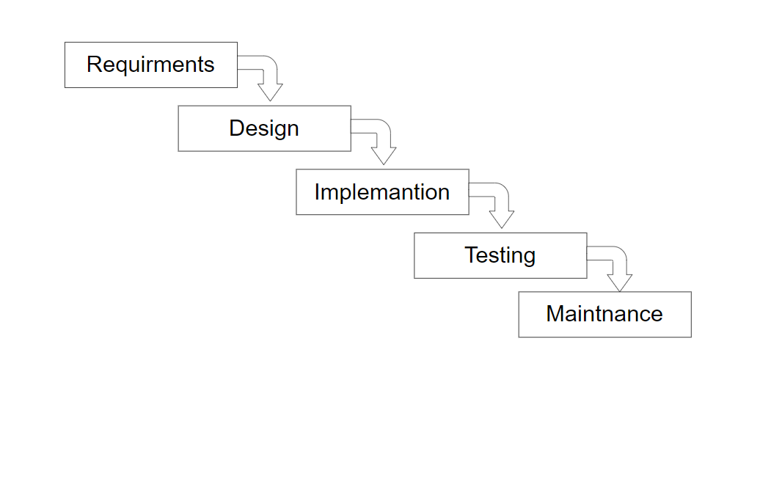
Development Methodology

Slide 6
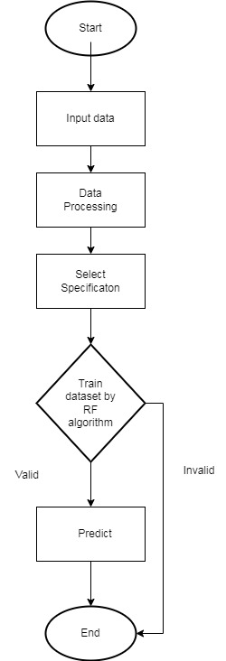
High level Design of system
Flowchart

Slide 7
Which algorithm?
Random forest algorithm
The Random Forest algorithm is a type of ensemble learning method used for both classification and regression tasks.
It works by creating many decision trees and combining their results to make a final prediction.

Slide 8
Why Random Forest algorithm
It takes less training time as compared to other algorithms.
It predicts output with high accuracy, even for the large dataset it runs efficiently.
It can also maintain accuracy when a large proportion of data is missing.

Slide 9
How it works
Step-1: Select random K data points from the training set.
Step-2: Build the decision trees associated with the selected data points
Step-3: Choose the number N for decision trees that you want to build.
Step-4: Repeat Step 1 & 2.
Step-5: For new data points, find the predictions of each decision tree, and assign the new data points to the category that wins the majority votes.
The working of the algorithm can be better understood by the below example:

Slide 10
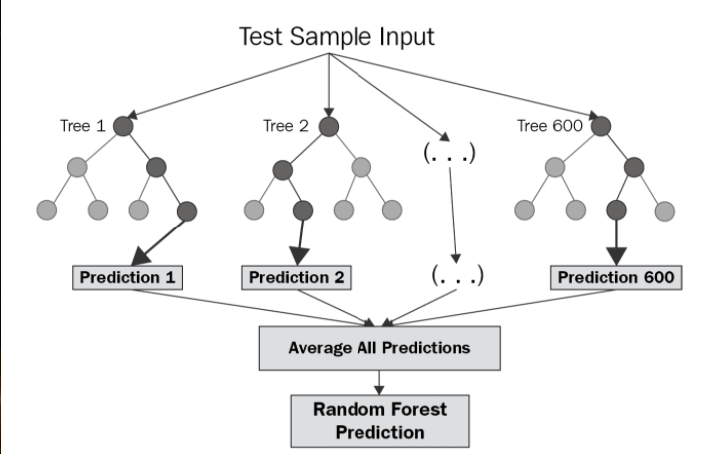
The working of the algorithm can be better understood by the below example

Slide 11
Pseudo Code
1. Initialize parameters:
a. Number of trees, N
b. Subset size of features, M
2. For i = 1 to N:
a. Draw a bootstrap sample (random sample with replacement) from the dataset.
b. Build a decision tree using the bootstrap sample:
i. While the tree is not grown to its maximum depth:
1. Select M random features from the dataset.
2. Choose the best feature and split point from the M features to split the node.
3. Split the node into two child nodes.
4. Repeat recursively for each child node.
3. To make a prediction for a new instance:
a. Pass the instance through each of the N trees.
b. For regression:
i. Average the predictions from all N trees.
4. Output the final prediction.

Slide 12
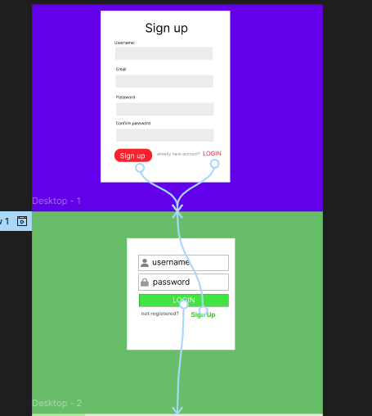
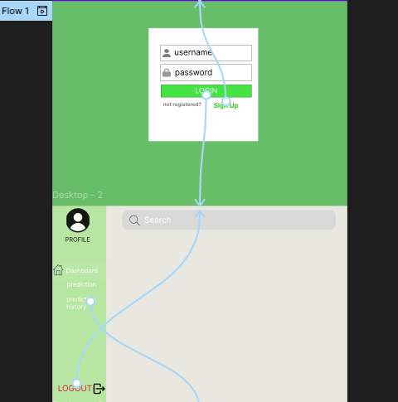
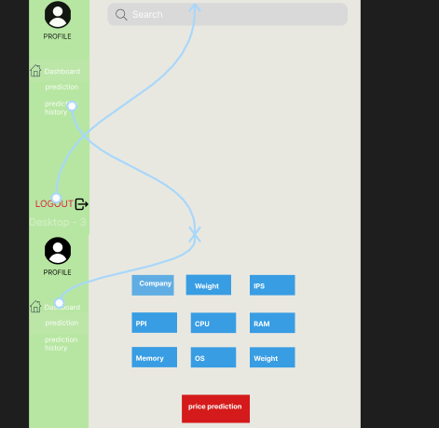
Figma Design and flow

Slide 13
THANK YOU

